Slide 1
Tuning VSC

Slide 2
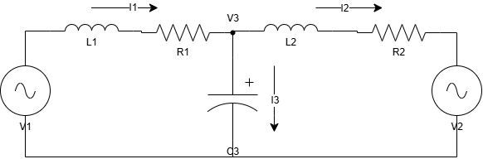


Plant Transfer Functions: Built wit Matlab SCAM Tool *
Inner Loop Plant
Outer Loop Plant (Voltage)
$$G_{1}=\frac{I_{1}}{V_{1}}=\frac{C_{3}L_{2}s^{2}+ C_{3}R_{2}s − 1}{C_{3}L_{1}L_{2}s^{3} + \left(C_{3}L_{1}R_{2} + C_{3}L_{2}R_{1}\right)s^{2} + \left(L_{1} + L_{2} + C_{3}R_{1}R_{2}\right)s + R_{1} + R_{2}}$$
$$G_{2}=\frac{V_{3d}}{I_{1q}}= −\frac{L_{2}ω}{C_{3}L_{2}s^{2}+ C_{3}R_{2}s − C_{3}L_{2}ω^{2}+ 1}$$
Outer Loop Plant (Power/DC Dynamics)
PLL
$$G_{3}′=\frac{\tilde{P\left(V_{DC}\right)}}{I_{1d}}= −\frac{\sqrt{3}}{\sqrt{2}}\frac{V_{d30} }{C_{3}L_{2}s^{2}+ C_{3}R_{2}s − C_{3}L_{2}ω^{2}+ 1}∗\left(−\frac{1}{{sC}_{DC}V_{DC_{0}}}\right)$$
$$G_{4}=\frac{V_{3q}}{θ}=\frac{L_{2}ω}{C_{3}L_{1}L_{2}s^{3}+ \left(C_{3}L_{1}R_{2} + C_{3}L_{2}R_{1}\right)s^{2}+ \left(− 3C_{3}L_{1}L_{2}ω^{2}+ L_{1} + L_{2} + C_{3}R_{1}R_{2}\right)s + R_{1} + R_{2} − C_{3}L_{1}R_{2}ω^{2}− C_{3}L_{2}R_{1}ω^{2}}$$
*Based on Modified Nodal Analysis: it uses systems in Netlist form and builds the analytical relationship of every voltage and current

Slide 3
Automatic Tuning Process
Matlab scritp for tuning
Validation in Simulink
Upload values in an Excel file
Run the PSCAD validation with the values from the Excel file
Excel file with nominal values

Slide 4
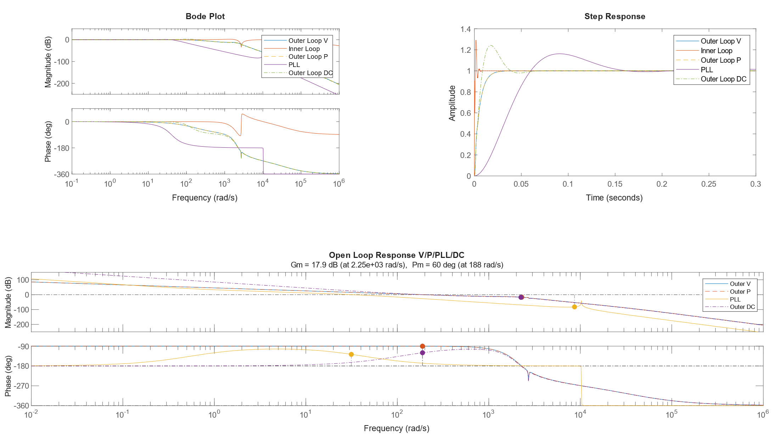
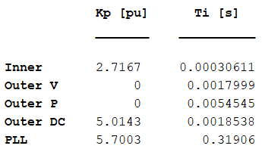
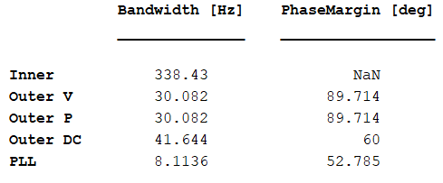
Name | Value | Unit
Ts | 1.00E+01 | us
f_base | 50 | Hz
V_base | 220 | kV
P_base | 120 | MVA
L_vsc | 0.031831 | H
C_filt | 3.18E-07 | F
R_vsc | 0.5 | Ohm
R_filt | 1.38 | Ohm
R_grid | 0.5 | Ohm
L_grid | 0.031831 | H

Slide 5
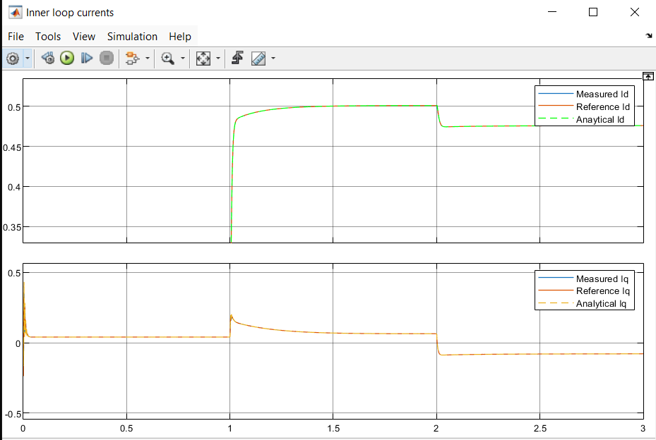
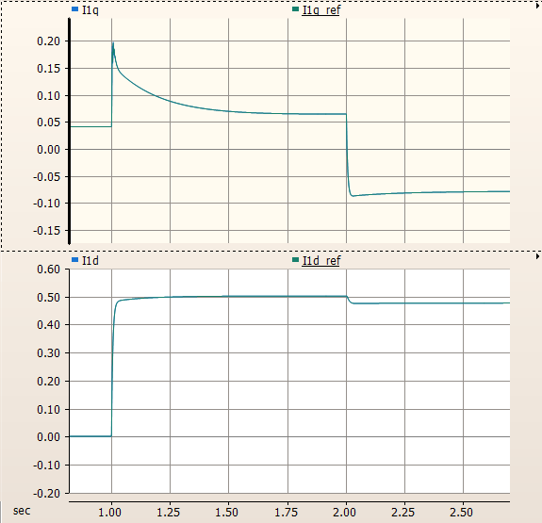
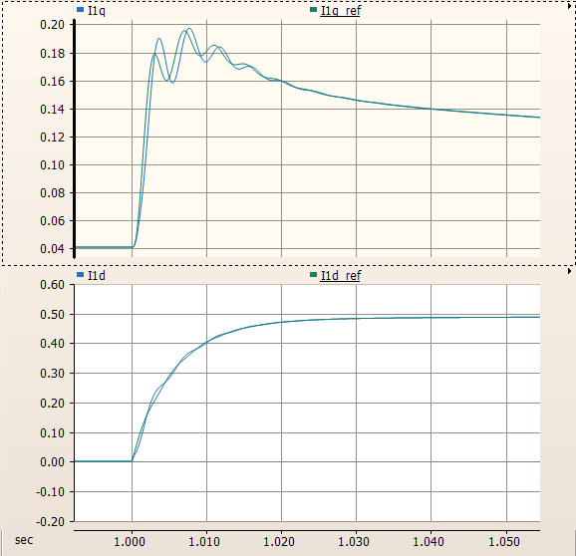
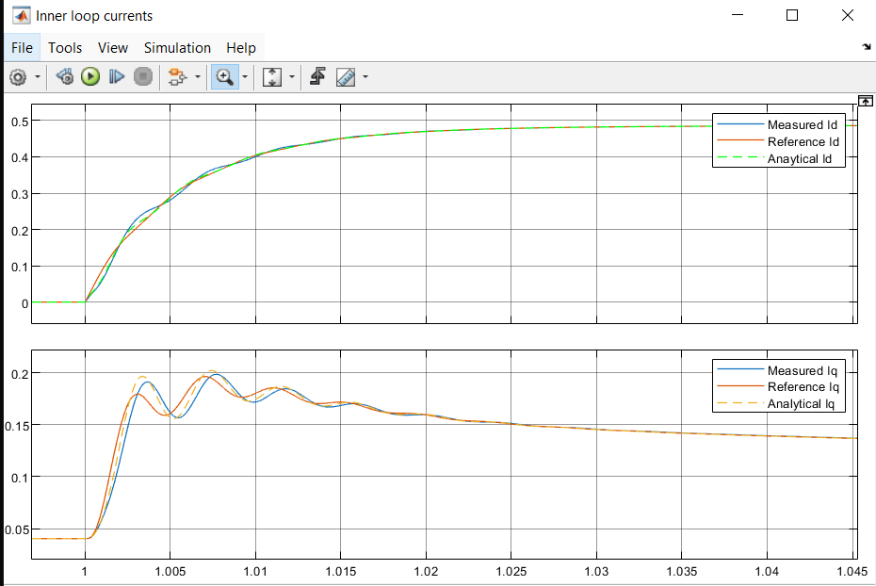

Slide 6
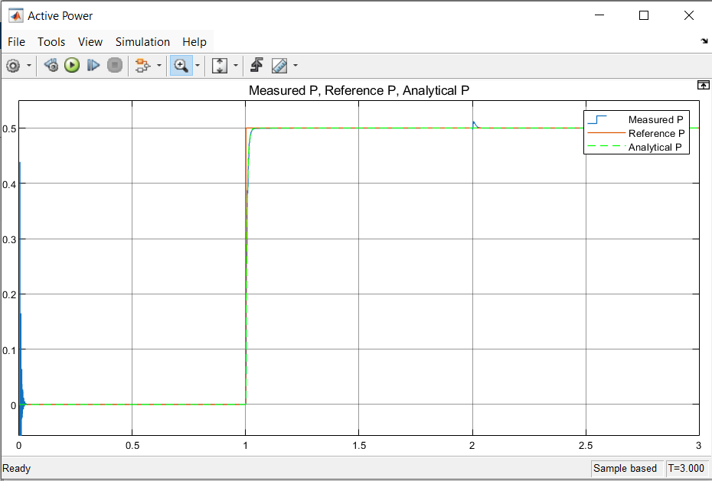
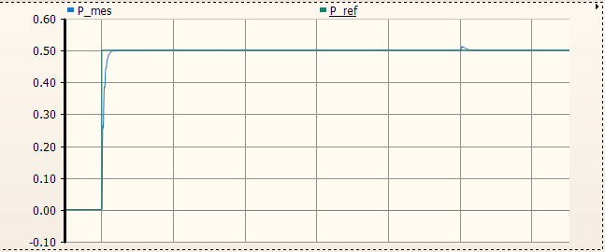
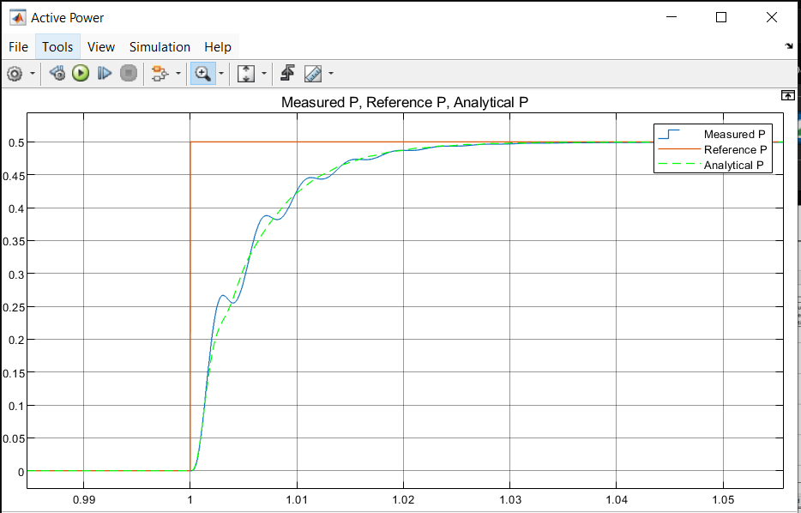
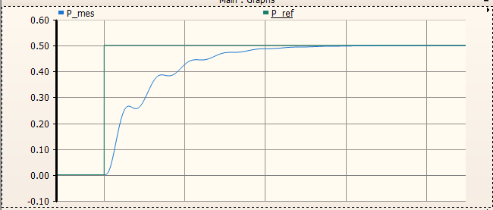

Slide 7
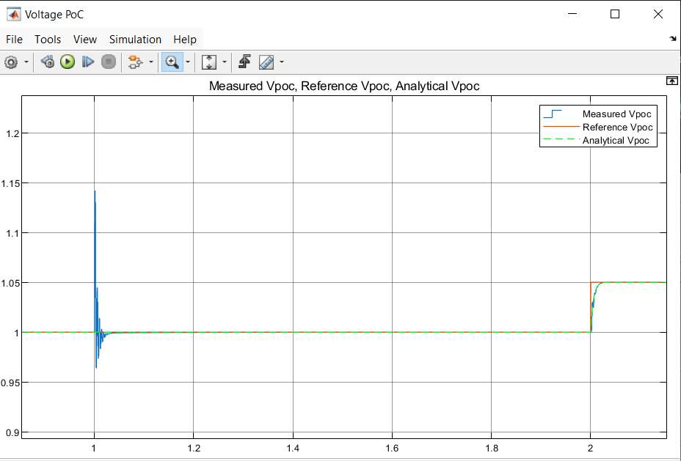
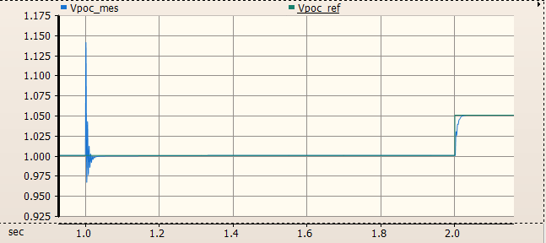
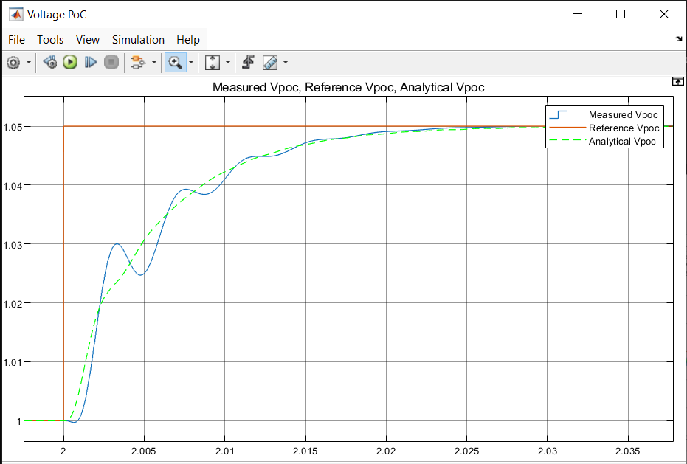
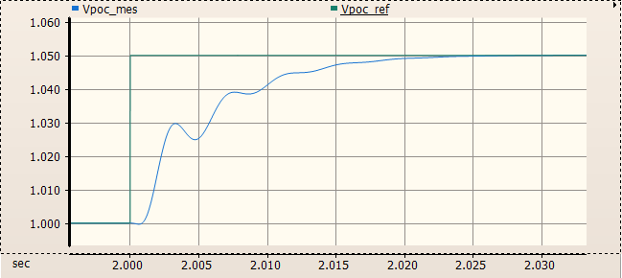

Slide 8
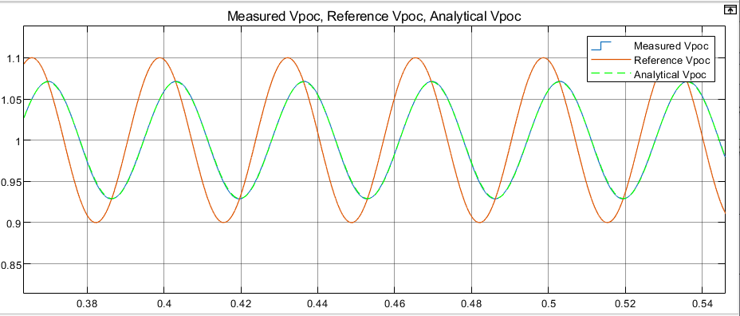
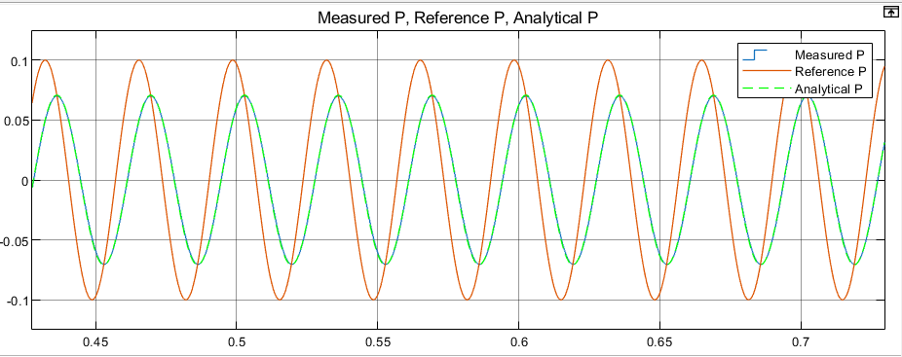
BW validation
BW_Power = 30 Hz
BW_Voltage = 30 Hz

Slide 9

Performance sum-up
Considerations
Inner loop depends strongly on the grid side as well
The outer loop does not depend on VSC’s impedance
PLL affects the o uter loops harder
The outer loop can have Kp(s) = 0
The common assumption that outer loop proportional gain will affect the low frequency impedance cannot be applied
The use of outer loop Kp’s where not necessary can deteriorate the Phase Margin, in fact
Inner loop:
Extremely accurate without PLL
Extremelly accurate with PLL + strong grid
Accurate with PLL + weak grid
Outer loop voltage:
Extremely accurate without PLL
Extremelly accurate with PLL + strong grid
Ok with PLL + weak grid
Outer loop power:
Ok without PLL
Ok with PLL + strong grid
Inaccurate (but still OK) with PLL + weak grid
Statcom Case | PM Analytical | PM Real
Outer V | 89 deg | 88 deg
Outer P | 89 deg | 91 deg

Slide 10
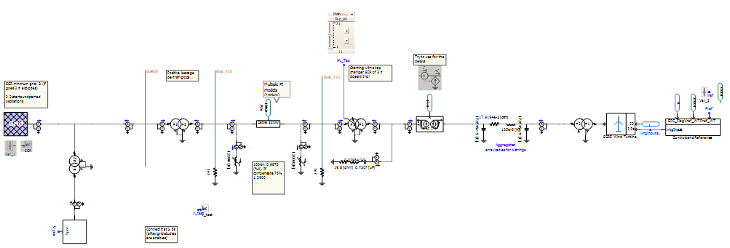
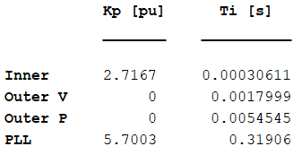
ESCR Test
100Km
14MW x 17 WTs = 230MW
Sn = 120MVA
Vn = 220kV
Designed to compensate 75% of the Cable’s capacitive effect

Slide 11
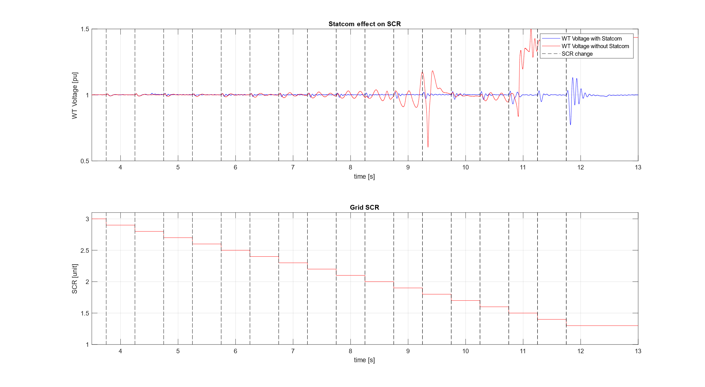

Slide 12
Equivalent impedance test

Slide 13
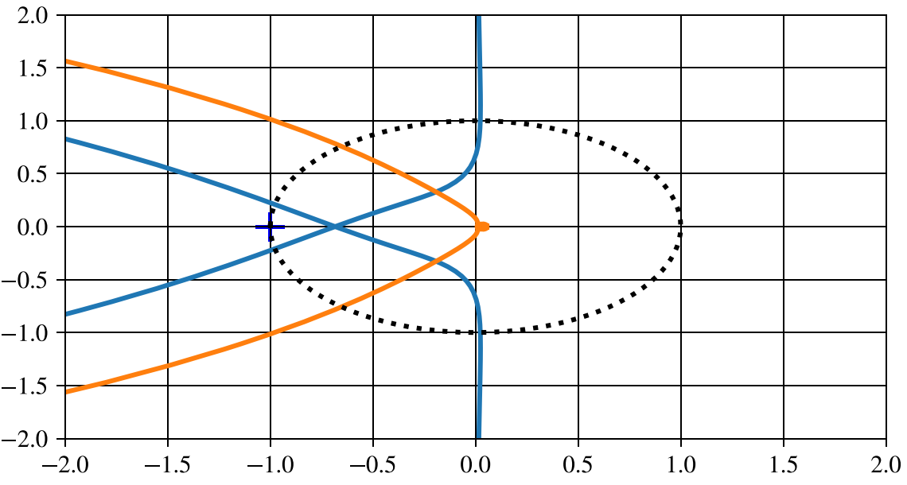
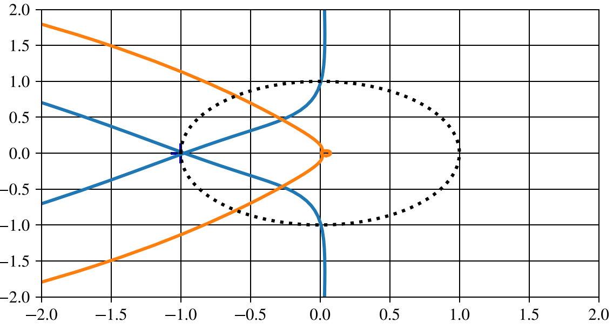
Generalized Nyquist
Grid SCR = 3
Grid SCR = 2.1
Phase Margin
Phase Margin

